Slide 1

Lending Club Case Study
-Vishal S. Gawande

Slide 2
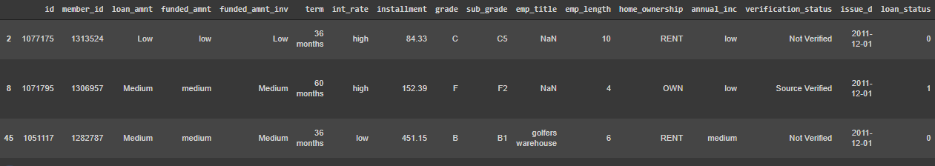
Data sample:
We are provide with loan approval data where the target variable is “Loan_status”. This column has results like “Fully paid”, “Current”, “Charged Off”.
We are going to provide analysis of how some contents like “Grade”, ”Annual Income”, ” interest rate”, etc. are affects the loan status.
Here is sample dataset:

Slide 3
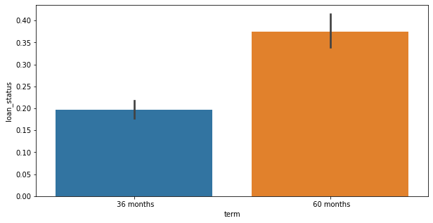
Default rate:
According to our analysis, the people who has fully paid the loan are around 32145 and the people who are still paying or haven't paid are 5399.
We have further analysed that in these numbers major defaulters are of 60 months debt.

Slide 4
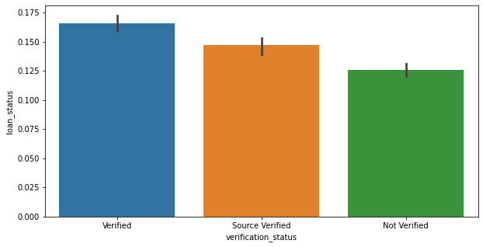
The shocking analysis was the LC verified people are more in default.

Slide 5
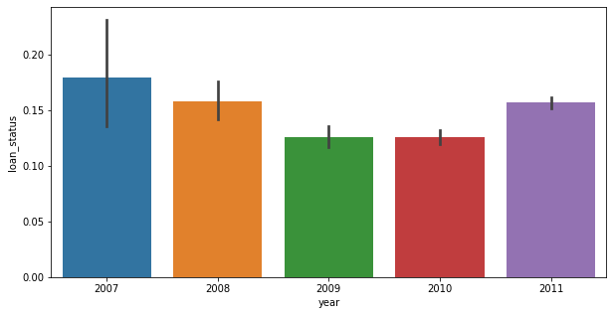
When we analyzed this rate according to time. We got the rate was decreeing up to 2010 but it eventually increased in 2011.

Slide 6
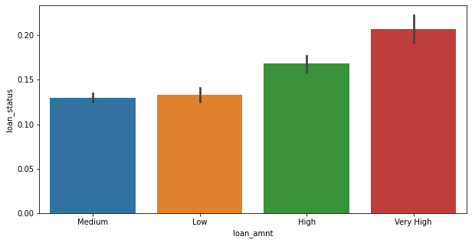
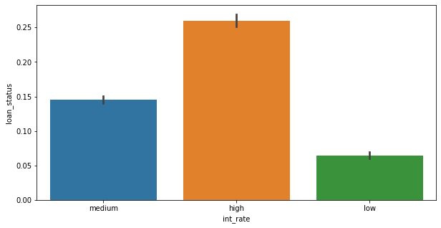
Another report says more the loan amount and more the interest rate the default rate is more.

Slide 7
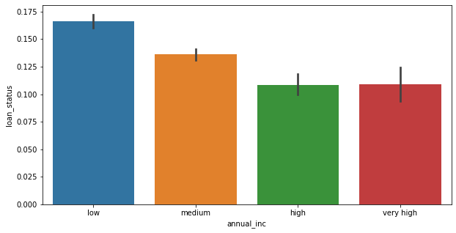
Annual income also affects the number of defaulters.

Slide 8
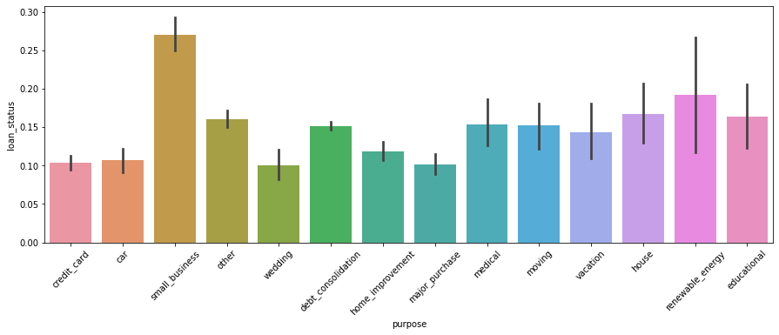
Another result was of purpose for which loan is taken.
The small business got the major defaulters.

Slide 9
From these analysis we came to some conclusions where bank should think twice before approving loan:
Make a category of loan amount to be granted according to the annual income of person.
Make the interest rate in the medium range so people would pay at given time.
If small business are applying are loan first verify the sales or revenue of company according to that numbers grant the loan. So there will be less possibility of being defaulter.

